Slide 1
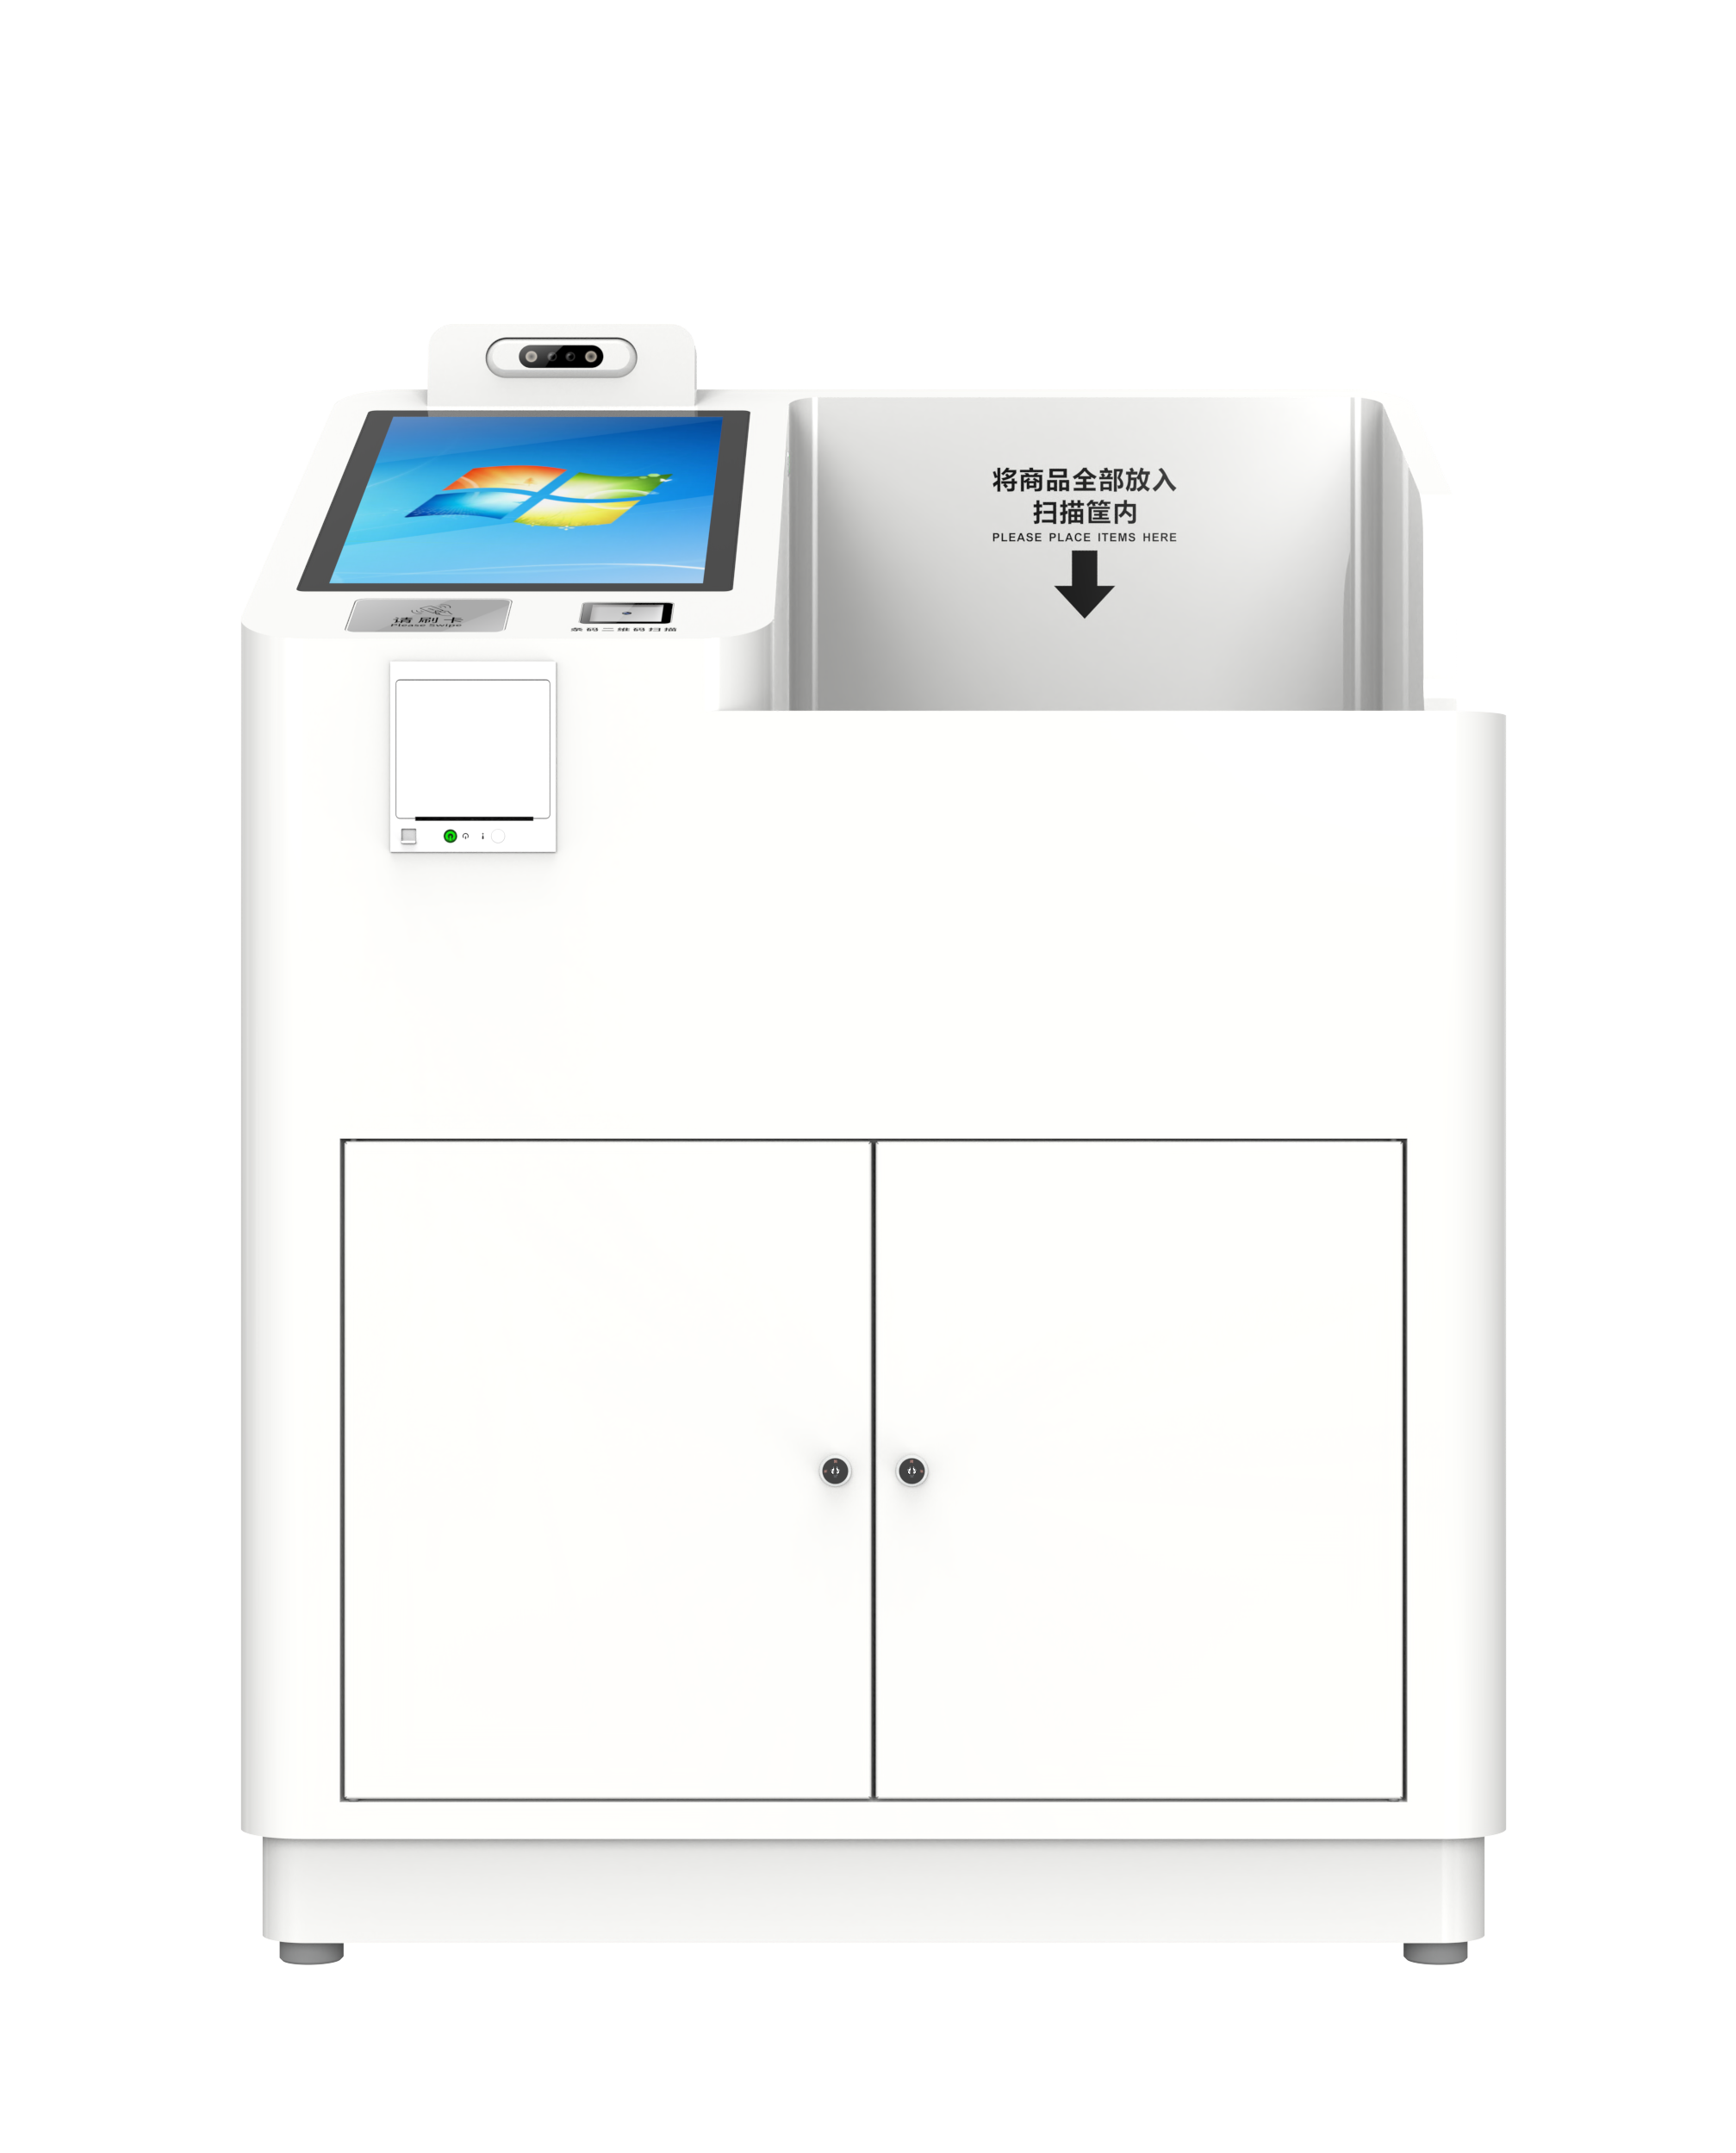
CYKEO-DP11D
Self Checkout RFID Kiosk
The CYKEO-DP11D is built for no-staff retail. Drop the items in, it reads everything at once, processes payment, and updates the RFID security in a few seconds. Sales data syncs instantly, and the large 21.5″ touchscreen keeps the flow simple for shoppers. It runs on Windows or Android, so it fits right into existing setups.
21.5-inch capacitive touch screen with 1920 × 1080 resolution
RFID technology 840~960MHz optional, support protocol extension
Multiple communication interfaces: RJ45， wifi, 4G etc
Support multiple permission setting, function expansion
Support registration of card information, optional Windows/Android system
Product appearance, function, protocols etc support customization

Slide 2
Specification
Model | CYKEO-DP11D
| RF SPECIFICATION
Identification Method | UHF
RF Chip | Impinj R2000
Frequency Range | 840MHz～960MHz adjustable
Protocol | EPC C1G2, ISO 18000-6B, ISO 18000-6C
Frequency Band (Optional) | ETSI: 865～868MHz, JP: 916.8～920.4MHz, TW: 922.25~927.75MHz, ID: 923.125~925.125MHz, RUS: 866.6~867.4 MHz, TEST: 802.75~998.75MHz, JP_LBT: 916.8~920.8MHz
RFID Item Reader | 30 pcs
Function | Read & write function, Multiple label identification, Label data filtering, RSSI perception, Quantity statistics, Self-service card application
| HARDWARE SPECIFICATION
System Support | Windows / Android (optional)
Hardware | I5 CPU, 4G RAM, 128G ROM / RK3399 CPU, 4GRAM, 16G ROM (optional)
Display | 1920 x 1080, 21.5-inch capacitive touch screen
Communication | RJ45 10/100Mbps
| FUNCTION SELECTION
RFID Read & Write
Bar Code | Standard
QR Code | Standard
Fingerprint Recognition | Optional
Face Recognition | Standard
Sound Light Alarm | Optional
Keyboard | Optional

Slide 3
Solar Energy | Optional
Wireless Network | WiFi / 4G
| BASIC SPECIFICATION
Material | Carbon steel plate, Glass
Power Supply | AC 110-220V 50Hz 50W
Working Humidity | 10%RH~90%RH
Operat Temperature | 0 ºC ~ 60 ºC
Size | 124.3x 89x 65 cm

Slide 4
Related Model
/
Common Solution
Smart Library, Archival Room, Tool Room, Supermarket, etc.
Dimension
Unit : mm (inch)
Weight. : about 100kg
Accessory
serial number | name | units | quantity
1 | power supply | pcs | 1

Slide 5






RFID IoT Application
Need Advice
Subscribee
Follow us: Cykeo
Headquarters
Subsidiary
Cykeo Information Technology CO., LTD.
Hefei Jianshen InformationTechnology Co., LTD.
16th floor, Building B2, Yunzhi Science Park, Guangming District, Shenzhen 518107, China
Cykeo Information Technology(Shandong) Co., LTD.
Cykeo Information Technology(Chengdu) Co., LTD.
Factory
Cykeo Core Information Technology (Shanghai) Co., LTD.
Shenzhen, Dongguang, Hefei

