Slide 1
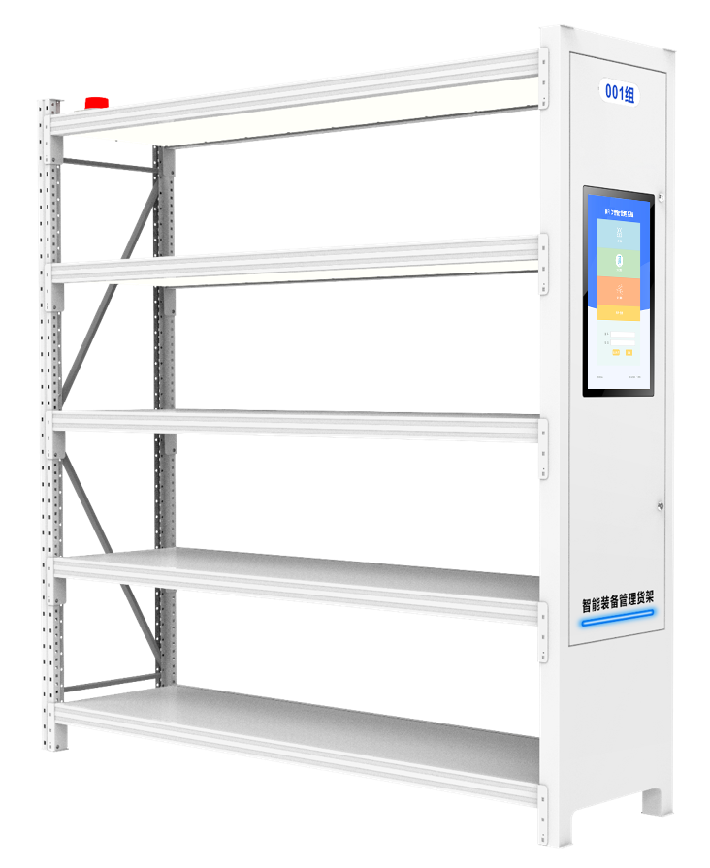
CK-H2C
INDUSTRIAL RFID SMART SHELF​
The CK-H2C Industrial RFID Smart Shelf is a cutting-edge storage solution designed for modern warehouses and equipment rooms. Utilizing 840-960MHz UHF RFID technology with 99.95% read accuracy, it enables real-time tracking of tools, safety gear, and inventory items. The rugged 1.2mm carbon steel construction and Windows/Android compatible system ensure reliable 24/7 operation in demanding industrial environments.
Automatic inventory: it can set up a regular inventory or active inventory, and realize daily inspection and monthly inspection within 10 seconds
High accuracy: special design, avoid RFID signal interference, single recognition rate is higher than 99.95%
Data collection and scientific analysis: real-time inventory records of goods, light up the location according to the item type
Convenient storage and placement: the use of weighing tray management of medical materials, other things convenient storage box classification placement
Support he side of the shelf can be equipped with a wall-mounted machine, as the main operation screen of the shelf, for information interaction

Slide 2
Specification
Model | CK-H2C
| RF SPECIFICATION
Identification Method | UHF
RF Chip | Impinj R2000
Frequency Range | 840MHz～960MHz adjustable
Protocol | EPC C1G2, ISO 18000-6B, ISO 18000-6C
Frequency Band (Optional) | ETSI: 865～868MHz, JP: 916.8～920.4MHz, TW: 922.25~927.75MHz, ID: 923.125~925.125MHz, RUS: 866.6~867.4 MHz, TEST: 802.75~998.75MHz, JP_LBT: 916.8~920.8MHz
Product Capacity | 1000 pcs (according of item size)
Communication | RJ45 10/100Mbps
Function | RFID read function, Multiple label identification, Label data filtering, Quantity statistics, Light indicator
| FUNCTION SELECTION
Weighing Function | Standard, accuracy 1g-30kg
Sound Light Alarm | Optional
CCTV Camera | Optional
Wireless Network | WiFi / 4G Optional
| BASIC SPECIFICATION
Material | Carbon steel plate
Power Supply | AC110-220V 50Hz
Operat Temperature | 0 ºC ~ 60 ºC
Size | 2000*500*2010mm

Slide 3
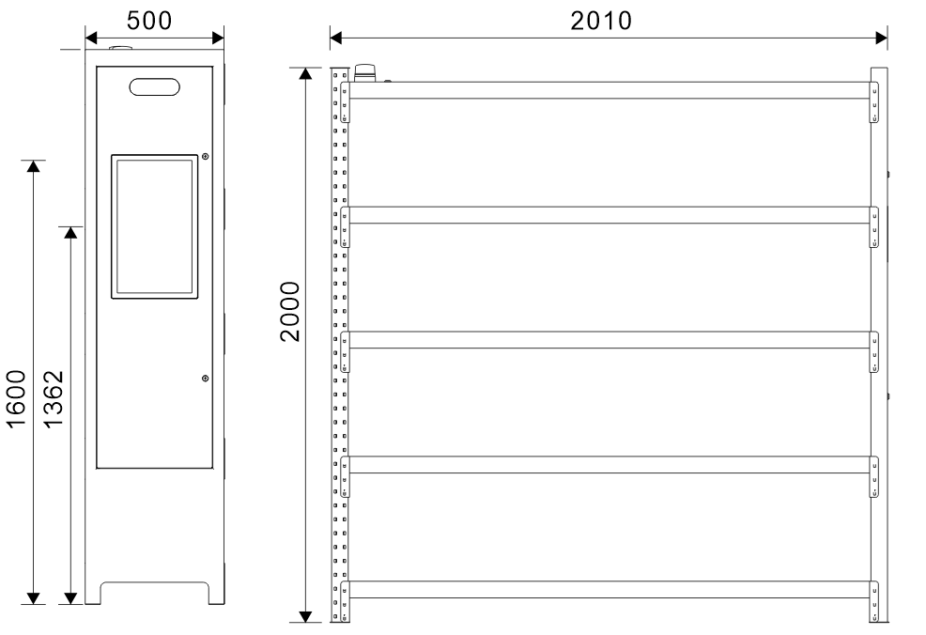
Related Model
Common Solution
Smart Library, Archival Room, Tool Room, Supermarket, etc.
Dimension
Unit : mm (inch)
Weight. : about 50kg
Accessory
serial number | name | units | quantity
1 | power supply | pcs | 1

Slide 4






RFID IoT Application
Need Advice
Subscribee
Follow us: Cykeo
Headquarters
Subsidiary
Cykeo Information Technology CO., LTD.
Hefei Jianshen InformationTechnology Co., LTD.
16th floor, Building B2, Yunzhi Science Park, Guangming District, Shenzhen 518107, China
Cykeo Information Technology(Shandong) Co., LTD.
Cykeo Information Technology(Chengdu) Co., LTD.
Factory
Cykeo Core Information Technology (Shanghai) Co., LTD.
Shenzhen, Dongguang, Hefei

