Slide 1
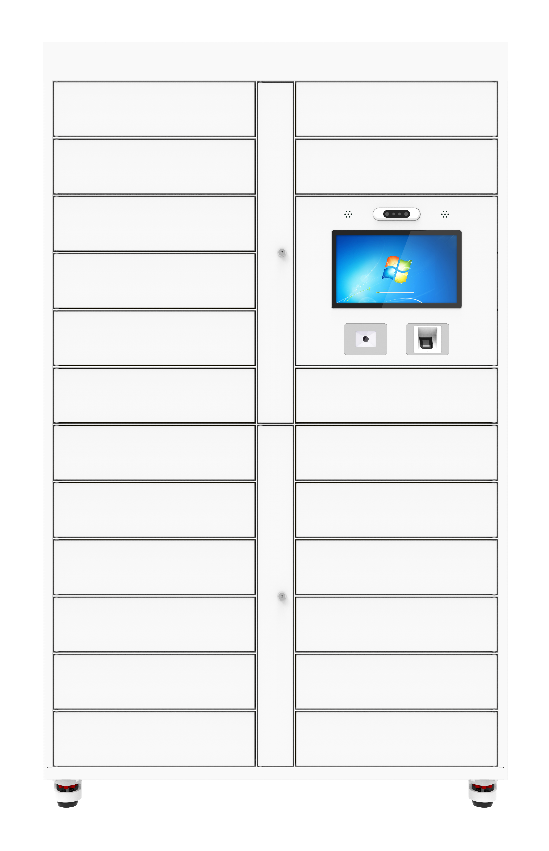
CK-G2124
Multiple Grids UHF RFID Cabinet Locker
Multiple Grids UHF RFID Cabinet Locker applicable to tool room, maintenance workshop, fire protection, nuclear power, railway rail transit and other use of UHF RFID technology to intelligent control of tools, documents, express and other items with UHF RFID tags, and real-time inventory of items in the cabinet. Record the information of the door opener, and support real-time upload, safety equipment rights management , quantity statistics, sound and light alarm and other functions
14-inch capacitive touch screen with 1920 × 1080 resolution
RFID technology 840-960MHz optional, support protocol extension
Multiple interfaces: RJ45, support wifi, 4G, alarm input etc
Support multiple cabinets in parallel, optional Windows / Android system
Saving manual inventory time and warehouse registration procedures, improve management and control efficiency, grid can be extended
Product appearance, function, protocols etc support customization

Slide 2
Specification
Model | CK-G2124
| RF SPECIFICATION
Identification Method | UHF
RF Chip | Impinj R2000
Frequency Range | 840MHz～960MHz adjustable
Protocol | EPC C1G2, ISO 18000-6B, ISO 18000-6C
Frequency Band (Optional) | ETSI: 865～868MHz;JP: 916.8～920.4MHz TW: 922.25~927.75MHz;ID: 923.125~925.125MHz;RUS: 866.6~867.4 MHz TEST: 802.75~998.75MHz; JP_LBT: 916.8~920.8MHz
Function | RFID read function, Multiple label identification, Label data filtering, RSSI perception, Quantity statistics
Product Capacity | 1000 pcs (according of item size)
| HARDWARE SPECIFICATION
System | Windows / Android (optional)
Hardware | I5 CPU,4G RAM, 128G ROM / RK3399 CPU,4GRAM, 16G ROM (optional)
Display | 1920 x 1080, 14-inch capacitive touch screen(optional)
Communication | RJ45 10 / 100Mbps
||FUNCTION SELECTION
RFID Card Reader | Standard
Face Recognition | Optional
Bar Code | Optional
QR Code | Optional
Sound Light Alarm | Optional
Fingerprint Recognition | Optional

Slide 3
Solar Energy | Optional
CCTV Camera | Optional
Thermostatic Dehumidifier | Optional
Wireless Network | WiFi / 4G
| BASIC SPECIFICATION
Material | Carbon steel plate,Tempered Glass
Power Supply | AC110-220V 50Hz 150W
Working Humidity | 10%RH~90%RH
Operat Temperature | 0°-60°C
Size | 120 x 51 x 198 cm

Slide 4
Related Model
CK-GG1315,CK-G1315A
Common Solution
Smart Library, Archival Room, Tool Room, Supermarket, etc.
Dimension
Unit : mm (inch)
Weight. : about 150 kg
Accessory
serial number | name | units | quantity
1 | power supply | pcs | 1

Slide 5






RFID IoT Application
Need Advice
Subscribee
Follow us: Cykeo
Headquarters
Subsidiary
Cykeo Information Technology CO., LTD.
Hefei Jianshen InformationTechnology Co., LTD.
16th floor, Building B2, Yunzhi Science Park, Guangming District, Shenzhen 518107, China
Cykeo Information Technology(Shandong) Co., LTD.
Cykeo Information Technology(Chengdu) Co., LTD.
Factory
Cykeo Core Information Technology (Shanghai) Co., LTD.
Shenzhen, Dongguang, Hefei

