Slide 1
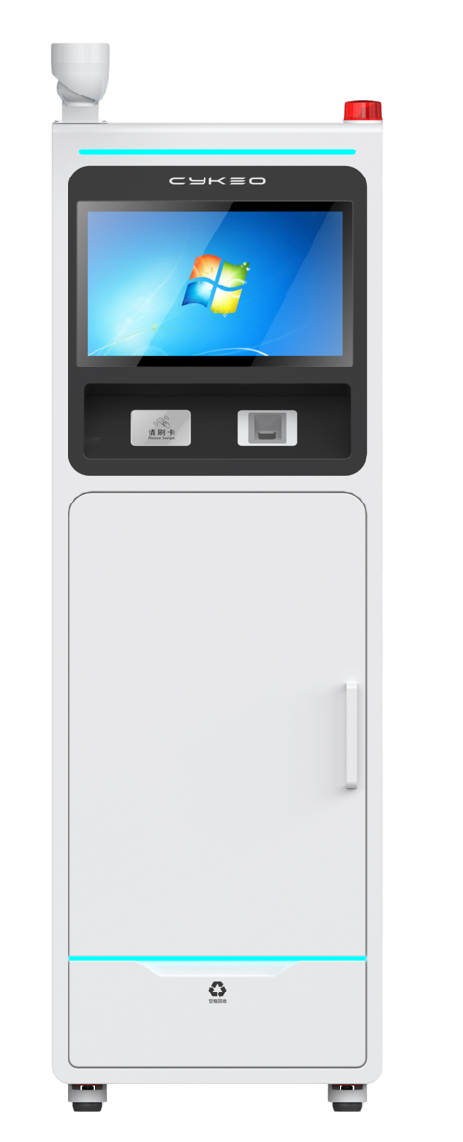
FTNG-L-CK-01
INTELLIGENT DRUG CABINET​
The FTNG-L-CK-01 Intelligent Drug Cabinet revolutionizes Schedule II drug management with military-grade security protocols. Its UHF RFID system tracks 1,200+ narcotic vials (NDC codes 0054-XXXX series) while maintaining ≤5cm read precision. Dual Intel i5-8365U & RK3399 processors enable real-time HIS/ERP integration with <200ms API response times.
22-inch capacitive touch screen with 1920 x 1080 resolution
RFID technology 840~960MHz optional, support protocol extension
Multiple interfaces: RJ45, support wifi, 4G, alarm input etc
Support multiple cabinets in parallel, optional Windows / Android system
Support automatic record receiving, return, constant temperature dehumidification preservation, regular calibration and inspection reminder
Product appearance, function, protocols etc support customization

Slide 2
Specification
Model | FTNG-L-CK-01
| RF SPECIFICATION
Identification Method | UHF
RF Chip | Impinj R2000
Frequency Range | 840MHz～960MHz adjustable
Protocol | EPC C1G2, ISO 18000-6B, ISO 18000-6C
Storage unit | 3 to 10 storage units, depending on the different storage capacities of single-door cabinets and double-door cabinets
Product Capacity | Manage ≥1000pcs of drugs (related to label performance, material and quantity of managed items)
Residual liquid recovery | Support independent recycling drawers
Identification range | The surrounding area is no more than 5cm
| HARDWARE SPECIFICATION
System Support | Windows / Android (optional)
Hardware | I5，8G+ 256G /RK3399, 4G+32G
Display | 1920 × 1080, 22-inch capacitive touch screen
Communication | RJ45 10/100Mbps
| FUNCTION SELECTION
RFID Card Reader | Standard
Bar Code | Optional
QR Code | Optional
Fingerprint Recognition | Optional
Face Recognition | Optional
Sound Light Alarm | Optional

Slide 3
CCTV Camera | Optional
Solar Energy | Optional
Wireless Network | WiFi / 4G
| BASIC SPECIFICATION
Material | Carbon steel plate, Tempered glass
Power Supply | AC 110-220V 50Hz 50W
Working Humidity | -25℃～+70℃
Operat Temperature | -20℃～+60℃
Size | 620mm(L)*650mm(W)*1800mm（H)

Slide 4
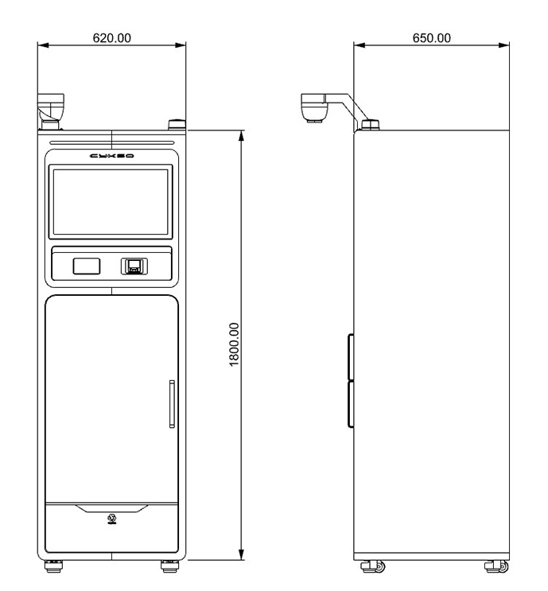
Related Model
FTNG-L-CK-02
Common Solution
Smart Library, Archival Room, Tool Room, Supermarket, etc.
Dimension
Unit : mm (inch)
Weight. : about 100kg
Accessory
serial number | name | units | quantity
1 | power supply | pcs | 1

Slide 5






RFID IoT Application
Need Advice
Subscribee
Follow us: Cykeo
Headquarters
Subsidiary
Cykeo Information Technology CO., LTD.
Hefei Jianshen InformationTechnology Co., LTD.
16th floor, Building B2, Yunzhi Science Park, Guangming District, Shenzhen 518107, China
Cykeo Information Technology(Shandong) Co., LTD.
Cykeo Information Technology(Chengdu) Co., LTD.
Factory
Cykeo Core Information Technology (Shanghai) Co., LTD.
Shenzhen, Dongguang, Hefei

